Slide 1
«Water Sector Reform in Kenya »
Trainings 24.-28.8. and 28.9.-2.10.2015

Slide 2
Public Health and Occupational Safety
Based on DWA/Engicon „Introduction to Wastewater & Health & Safety“, modified by Margraf Publishers

Slide 3
Table of Content
Self protection & safety equipment
Wastewater System Operator
Work in Manholes
Safety harness

Slide 4
Self protection & safety equipment:
Safety shoes – to protect the employee foot from cold, wet or falling of heavy weight things and from sliding..
Gloves – If there are injury risks or contagious diseases in the handwork.
Helmet – to absorb shock on the head under any circumstances.
Reflective vest – to indicate the employee on roads and nearby roads or in cloudy or rainy atmosphere and in areas with low efficient lighting.
Gas mask: in confine spaces
A respirator prevents you from inhaling any germs in the air

Slide 5
Self protection & safety equipment
Long sleeve safety boot – to protect the foot from wet and cold. And to protect the foot from contagious diseases available in the wastewater and contaminated water.
Raincoat – to protect the employee from wet under rain or snow and facilitate his work in such weather.
Lab coat – to protect the body and clothes of the employee when dealing with chemicals.
Earmuffs – to protect the hearing level of the employee from extreme sounds.

Slide 6
Self protection & safety equipment
Electricity-resistance equipment – to protect the employee from the risks of electrical shocks.
Goggles – to protect the eyes of the employee from dust or dispersed particles.
Face-shield – to protect the employee eyes from welding ray and heat.

Slide 7
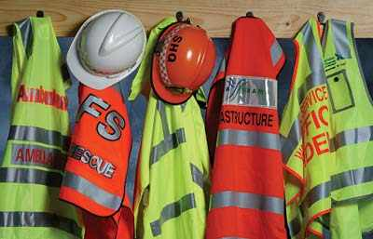
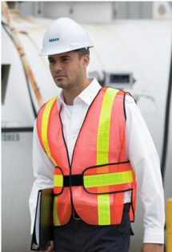

Slide 8
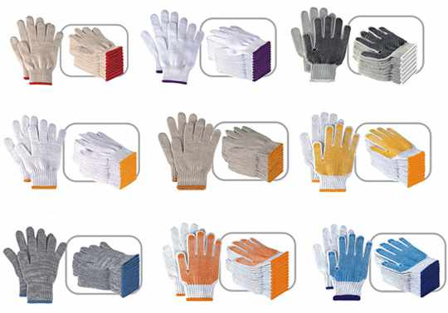

Slide 9
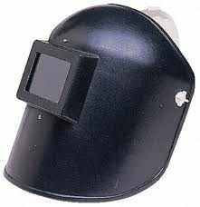

Slide 10
Wastewater System Operator
Operating wastewater networks is considered a job with special responsibilities which is full of challenges.
The operator is required to have specific qualifications such as above the average knowledge in many aspects,
good common sense that guides in decision making in different conditions and circumstances,
and shall be a highly trained and skilled professional.
The safety of the operator’s life is related to the operator’s experience and that is manifested in his/ her commitment to safely completing every task.

Slide 11
WW System Operator Protection
Protective procedures include the followings:
Protect yourself from getting infected by wearing the suitable clothes like gloves, chemical resistant clothing, Helmet, and safety boots.
Use creams to prevent your skin against organics that cause diseases. They also reduce dermatitis effects.
Use the first aid kit immediately- clean the effected area then use a disinfectant. Use a waterproof bandage.

Slide 12
First Aid Kit
A first aid kit shall always be ready and handy to operators at the manholes to be used right away.
At least one person in the team (more than one person is preferable) shall be trained on using the first aid kit and perform first aid procedures.

Slide 13
The WW System operator’s health state
The operator entering the manhole shall follow the following rules before entering:
Shall be in a good health state
Be in a good physical condition
Free from hangover or medication related side effects.
You shall not have any open wounds or blisters.
Shall have the up-to-date vaccinations required.

Slide 14
Work in Manholes
Entering manholes is considered a very dangerous task:
It has the potential for exposure to dangerous and flammable chemicals and gases.
It can also expose the workers to injuries, contagious diseases and insects.
However, the work in manholes can be safe if proper measures are being followed.

Slide 15
Expected Risks in Manholes
There following are the major hazards that face the operator in manholes:
physically injuries (slipping & falling construction failure, falling objects),
infectious disease,
insects and creatures that sting,
exposure to toxicants,
drowning

Slide 16
Safety harness with lifeline tripod and winch
Any person entering the manhole or a confined space is required to wear the safety harness.
The safety harness and lifeline can be used to lower the person down to the confined space.
Any network operator stays up while the other worker is under the ground (in the manhole) and that is to monitor the safety harness’s performance.
A third person shall be near them, for it is required to have two people to lift up an unconscious worker outside of the manhole.

Slide 17
Ropes and Buckets
Ropes and buckets are used to lower the tools into the manholes and lifting them up again.
The safety clasp prevents the bucket from swinging.
The dropping of tools and throwing them back up outside of the manhole had caused many injuries in the past.

Slide 18
Entering a manhole procedures (I)
Minimum staff is 3 persons.
Place a safety loop around the manhole if necessary.
Adjust the portable gas detector before moving the manhole’s cover.
Examine the entire depth of the manhole starting from its bottom to surface to determine the toxicants, flammable and explosive gases (H2S) and the shortage of Oxygen.
Check if there is any combustible mixture before removing the manhole’s cover if possible. Removing the manhole’s cover might produce a spark that can cause an explosion. This action is good also in knowing the ventilation conditions down the manhole.

Slide 19
Entering a manhole procedures (II)
Never use your hands to remove or return the manhole’s cover; use any approved winch.
Open the manhole from the top and bottom of the work site and that is to create a natural circulation in the manhole. Cover the manhole with grating and place barriers around the manhole to warn pedestrians and traffic.
Sweep the area before removing the manhole’s cover, and clean

Slide 20
Entering a manhole procedures (III)
The network operator ready to enter the manhole shall ensure that he had fastened the safety harness and lifeline correctly. The other workers or supervisor shall ensure that the safety protection clothing and equipment are safe and tied properly.
It is necessary to continuously monitor the air atmosphere at the manhole during the presence of the network operator, to examine the shortage, enrichment of the Oxygen, flammable and explosive toxicant gases.

Slide 21
While the operator in the manhole
Lifeline end shall be secured outside the confined space.
Oxygen shortage shall be examined continuously as long as the network operator is in the manhole, examining toxicant flammable and explosive gases (H2S).
Good ventilation prevents problems from happening inside the manhole.

Slide 22
While the operator in the manhole
A team worker present at the safety enclosure shall continuously monitor the network operator in the manhole and perform no other activities.
He should be attentive and secure everything in his pockets against falling down accidentally and injuring the network operator. The assistant shall always be ready for any call for help.
The network operator shall be pulled out of the manhole if any problem indications start to appear like irregular drainage, alerts from the atmosphere controller.

Slide 23
Post Exiting the Manhole
At the end of the working day, the worker who was present in the manhole shall take a shower and wear clean clothes before leaving work, for clothes worn in the manhole shall not be reused under any circumstances.
Don’t expose your family to the risk of contagious diseases should they touch that clothing.
Don’t wear any clothing that had been worn during wastewater network/home maintenance.
Don’t wash these clothing in your private washing maschine and keep the work uniform and the office uniform in separate closets.

